Slide 1
Weekly Report 14-15
Siyu Liao
Advised by Prof. Sun
2020.10.08

Slide 2
1.COHP and d band contribution
The following pictures show how band structure, DOS and Ga s,p,d COHP with P repectively when GaP’s lattice constant gradually change from 5.9Å to 5.15Å. d band COHP is about 10 times weaker than s or p COHP. To make it visible I enlarge x ticks by 10 times in d band COHP.

Slide 3
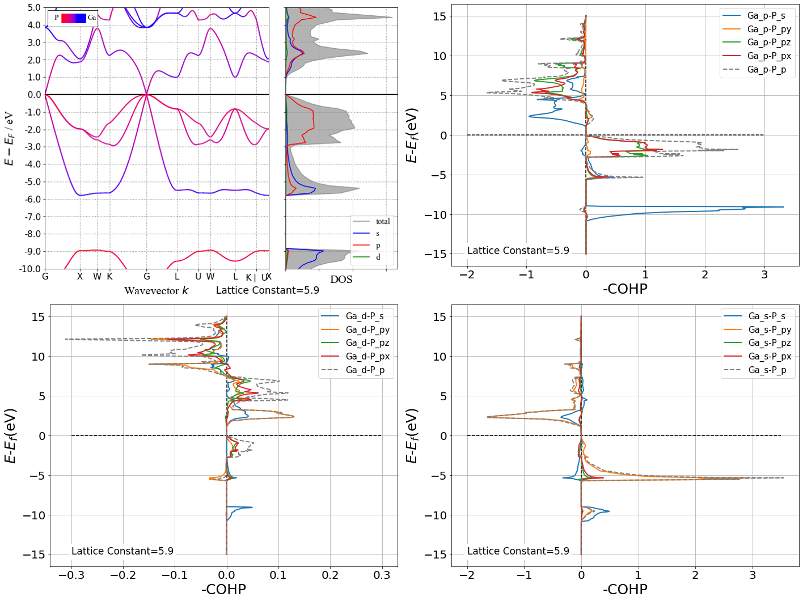
GaP 5.9Å

Slide 4
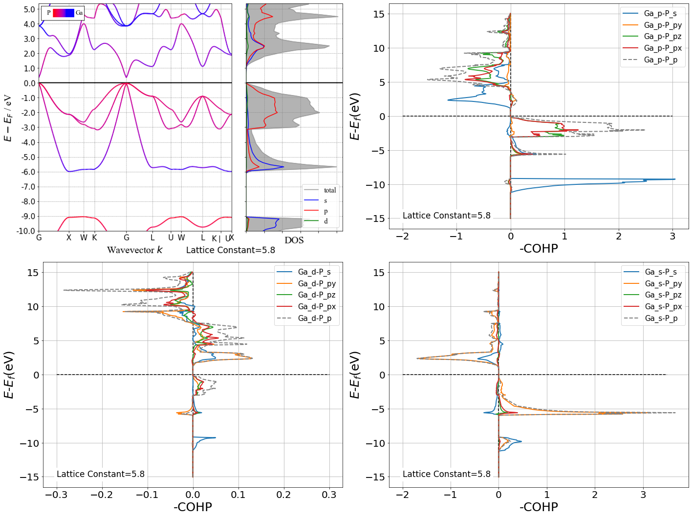
GaP 5.8Å

Slide 5
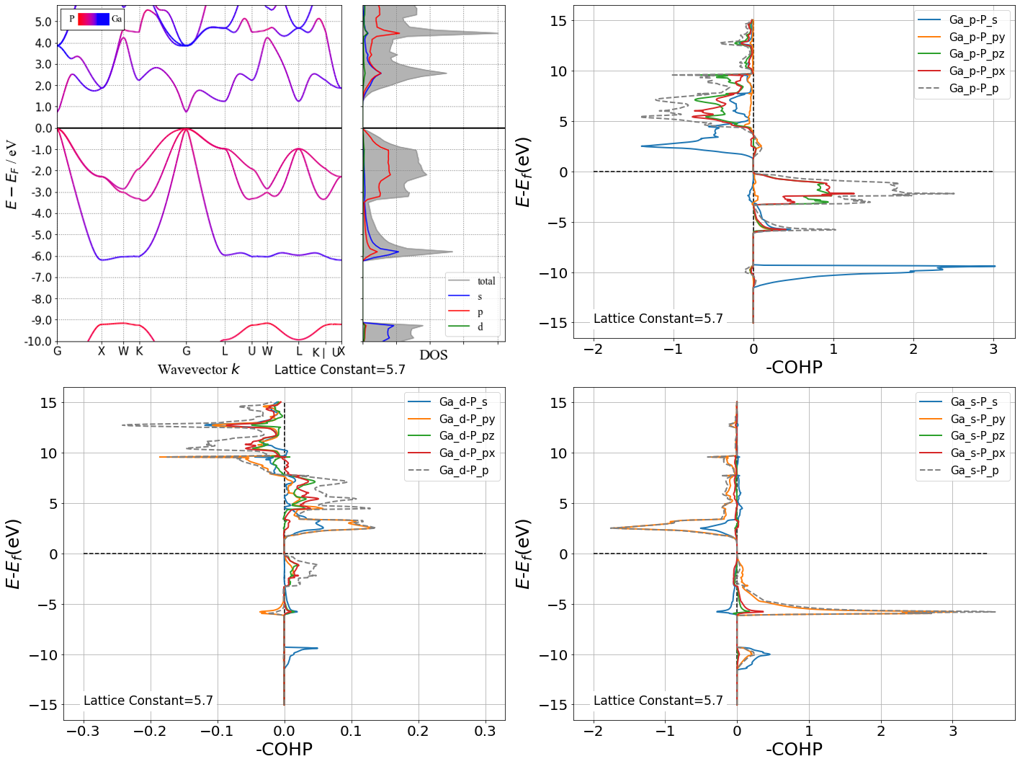
GaP 5.7Å

Slide 6
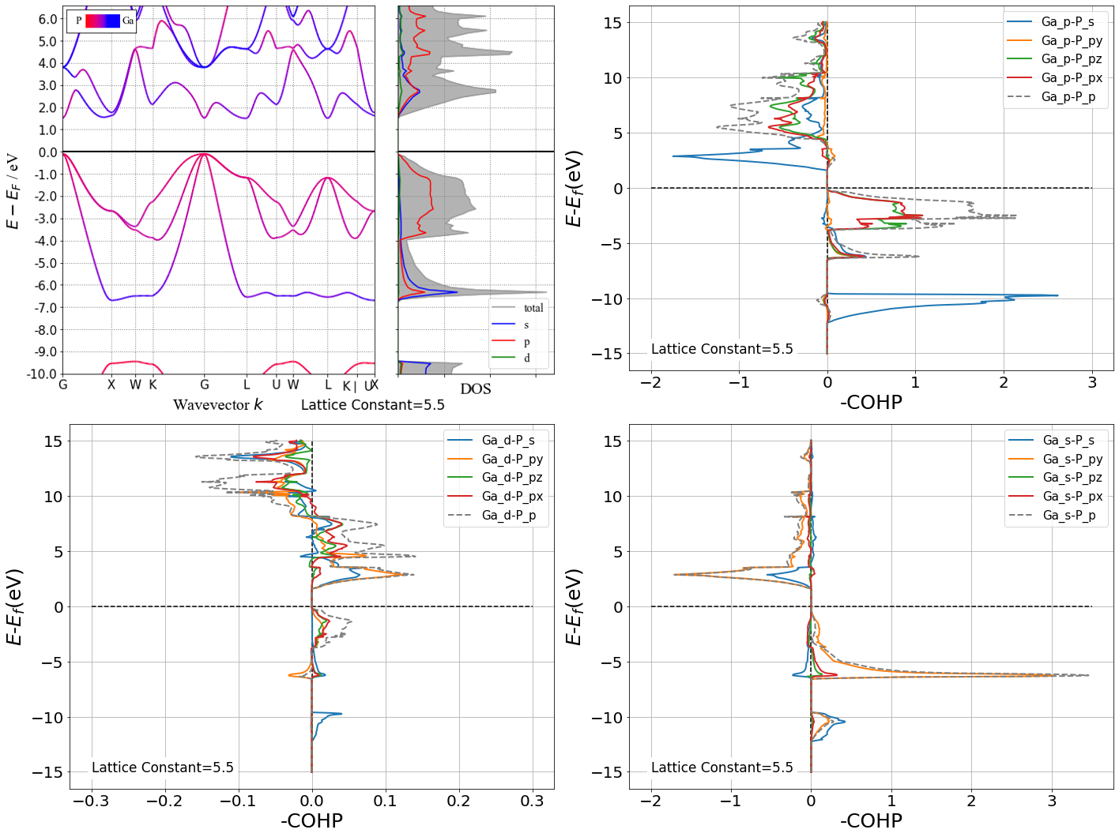
GaP 5.5Å

Slide 7
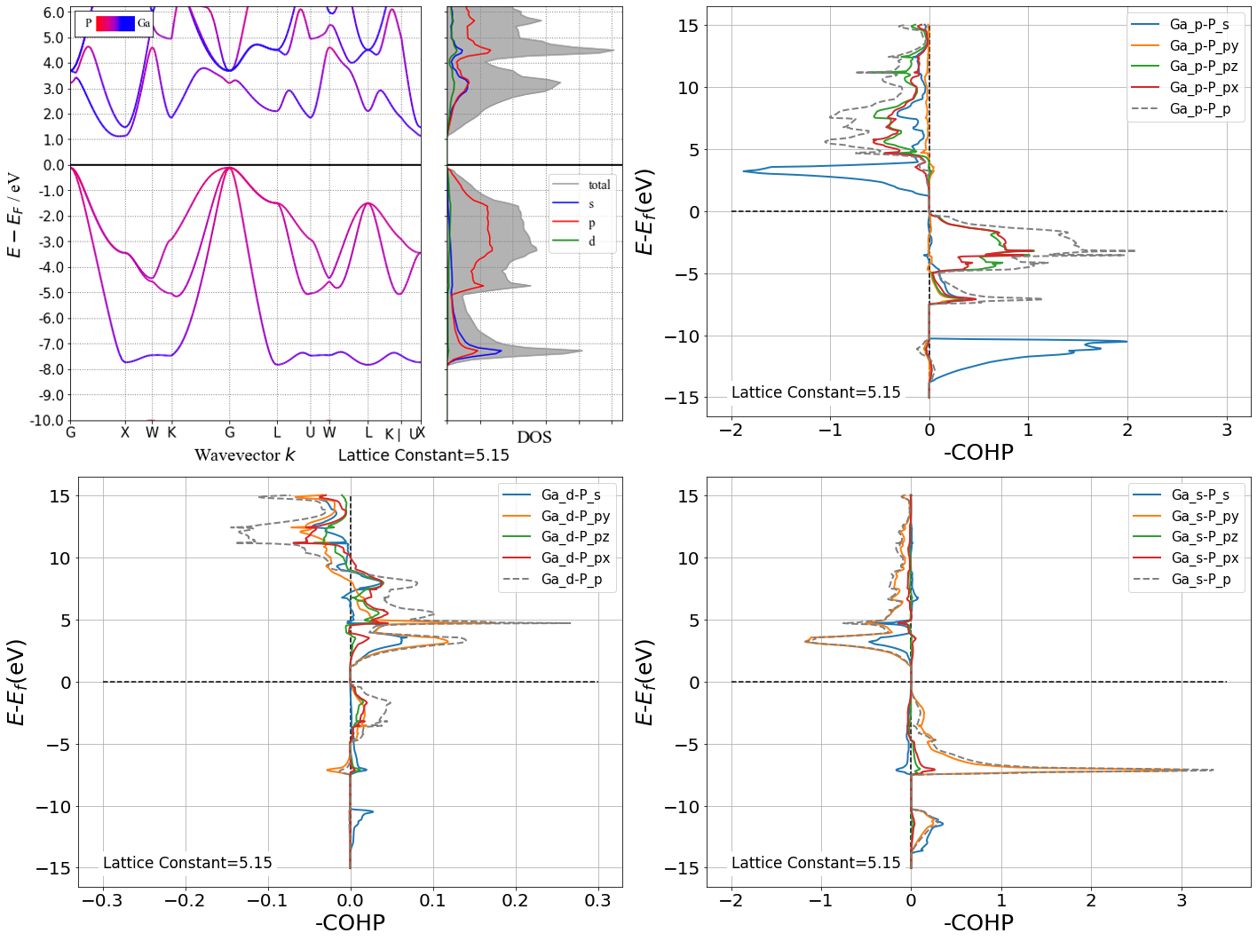
GaP 5.15Å

Slide 8
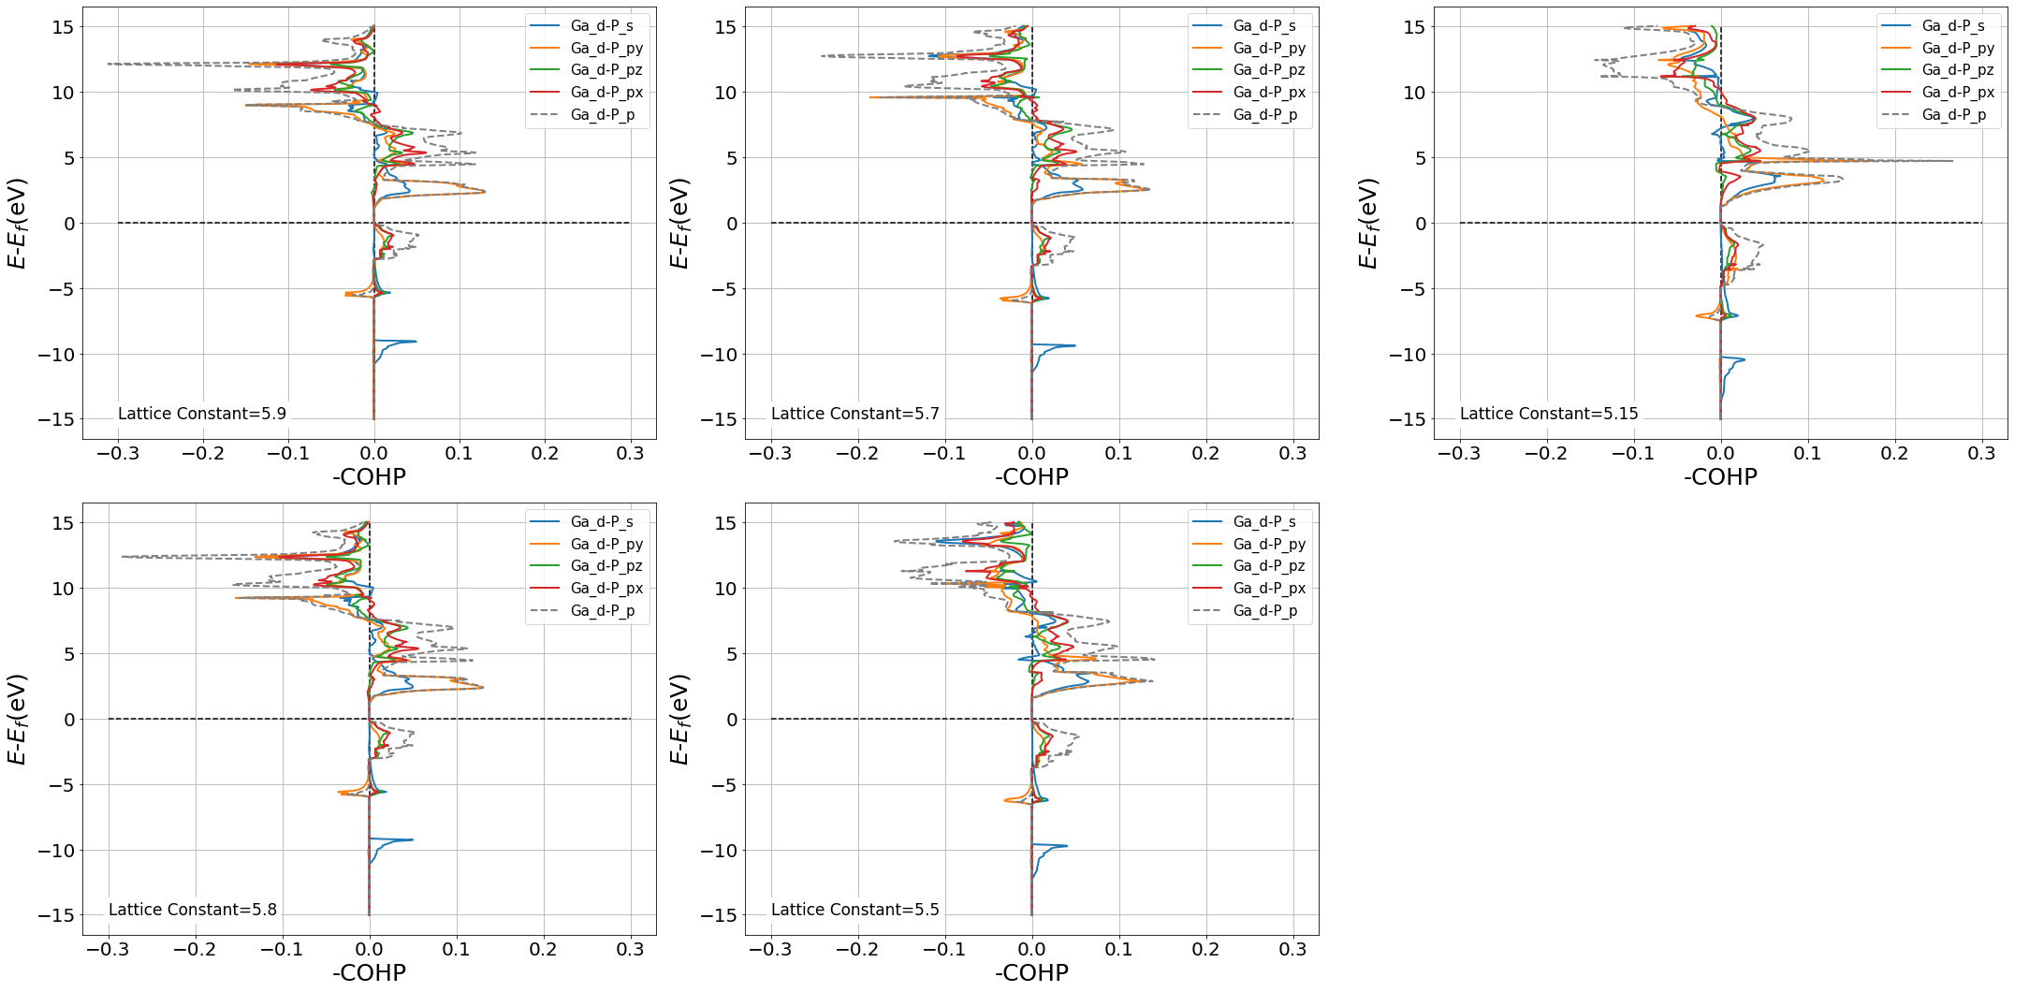
Ga d band COHP

Slide 9
Interpretation
The strongest COHP of d band is with P py orbital. To be specific, is dxz and dx2−y2. I suppose that could be explained by the principle of symmetry matching in chemical language. In group theory language, at the Γ point, the atomic d orbitals belong to Γ15 and Γ12, respectively, and thus have the same Γ15 irreducible representation as the p-like VB edge state; the coupling between p and d orbitals at the Γ point could be quite significant. However, the s-d coupling is forbidden because the atomic d orbitals have no common irreducible representations with the s-like CB Γ-valley state. Therefore, the existence of the occupied d orbitals will have a significant influence on the formation of the band gap by pushing the VBM up and leaving the CB Γ-valley intact. At the X point, five d orbitals belong to the X1, X2, X3, and X5 irreducible representations, respectively, and, therefore, can couple to the CB X valley. At the L point, five d orbitals belong to L1 and two L3, respectively, and same as the X point, the d orbital state can couple to the CB L valley.

Slide 10
Questions
From COHP we still fail to get the exact values of d band contribution to X and L valley. If it is enough to convert the CBM from Γ point to L point is still questionable. I don’t know whether we can get a band structure which totally ignores d band for comparison.

Slide 11
2. Band structure of Ga-groupⅤcompounds
I have accomplished the calculation of GaN, GaP and GaAs in zinc-blende structure. The following Videos are their band structure and DOS when lattice constant change from 20Å to slightly smaller than real values.
GaAs
GaP
GaN

Slide 12
Observations
The emergence of band gap:
GaAs: 5.78Å (real: 5.75Å)
GaP:5.88Å (real:5.50Å)
GaN:4.92Å (real:4.54Å)
GaN, by virtue of the strong electronegativity of N, represents a relative simple and different pattern from GaP and GaAs.
The band gap of Group Ⅲ-Ⅴ compounds is trivial situation in topology (unlike graphene which band structure is symmetry protected at Γ point), so I assume there is no need to emphasize too much on this point.

Slide 13
Observations
As we keep reducing lattice constant after the emergence of band gap, CB Γ valley continuously go up at high speed while CB L valley go up at a relative slow speed. On the contrary, CB X valley goes down during the process. In addition, GaP’s bandgap would change from direct to indirect at about 5.55Å. I think it would be interesting to describe it quantitatively using tight binding model. So I think next step is utilizing Wannier90 to acquire those parameters and combine them with PythTB.

Slide 14
S-P coupling
I suppose there is s-p coupling hybridization as long as there are s and p orbital contribution in the same place in DOS picture. Meanwhile, sp hybridization orbital is just a unitary transformation of regular sp orbitals.
In Wannier90 we can choose different sets of basis functions like sp3, sp3d2 or s,p,d. I’m wondering if there exists any physical difference in the result?

Slide 15
Thanks for watching!

